Slide 1
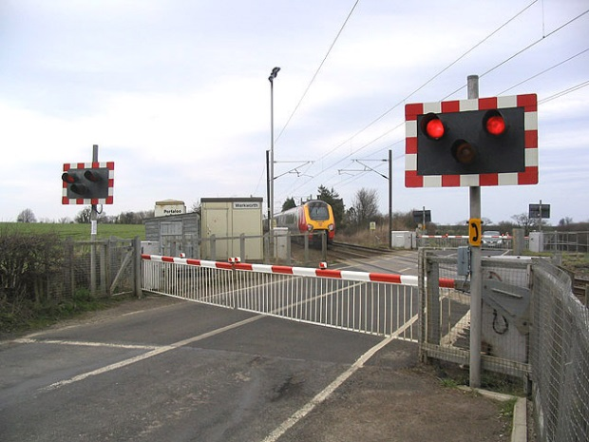
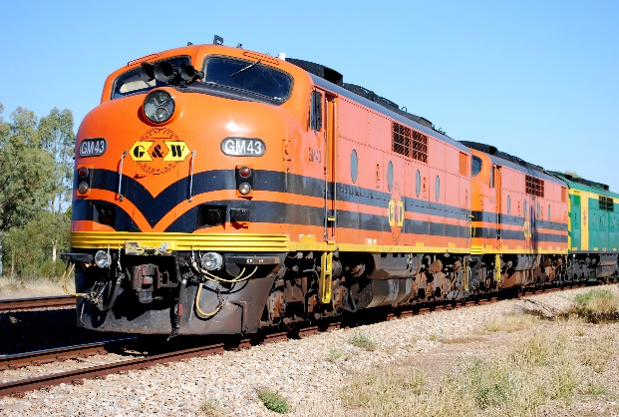
Rakshak - Automated Unmanned Railway Level Crossing Controller
- Amit Krishna A

Slide 2
Objective
Eliminate the accidents occurring at unmanned railway level crossings with the use of modern communication and automation technology
Provide a cost effective solution
Avoid manual errors: Radio Frequency Signalling between the train and the level crossing controller avoids manual errors
Automation helps to avoid cost of employing a guard 24x7 at the level crossing

Slide 3
Accidents at level crossings - Statistics

